Slide 1
Control Principles
Tutorial #3
Block Diagram

Slide 2






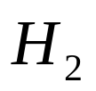
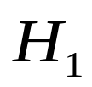



Block diagram
Transfer Function
Consists of Blocks
Can be reduced

Slide 3
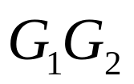
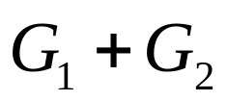

Reduction techniques
1. Combining blocks in cascade or in parallel
2. Moving a summing point behind a block

Slide 4

3. Moving a summing point ahead of a block
4. Moving a pickoff point behind a block
5. Moving a pickoff point ahead of a block

Slide 5
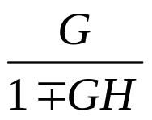

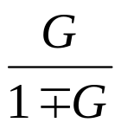



6. Eliminating a feedback loop
7. Swap with two neighboring summing points

Slide 6
Example 1
Find the transfer function of the following block diagrams
(a)
R
(
s
)

Slide 7

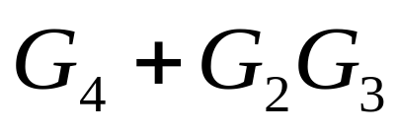
Solution:
1. Moving pickoff point A ahead of block
2. Eliminate loop I & simplify

Slide 8
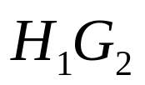


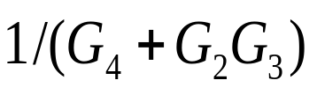
3. Moving pickoff point B behind block

Slide 9
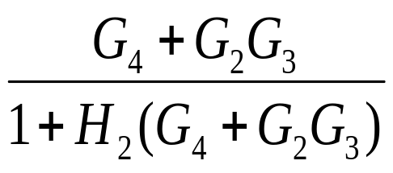
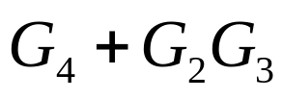
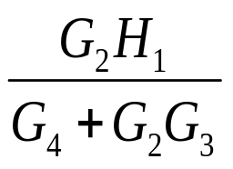
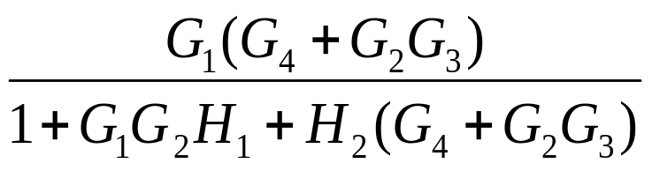
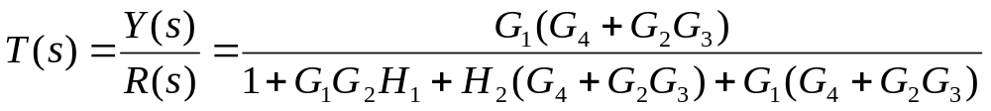
4. Eliminate loop III
Using rule 6

Slide 10
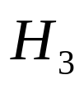
(b)

Slide 11
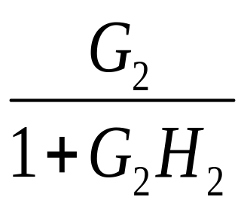
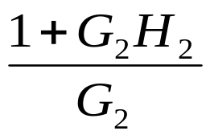
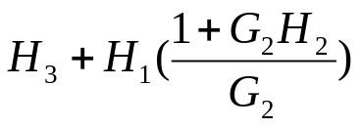
Solution:
1. Eliminate loop I
2. Moving pickoff point A behind block
Not a feedback loop

Slide 12
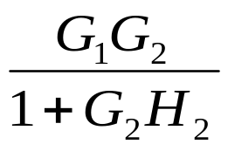
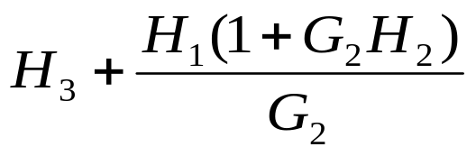
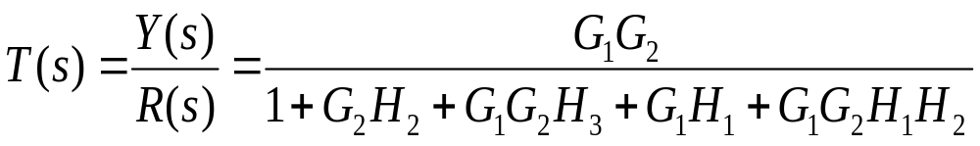
3. Eliminate loop II
Using rule 6

Slide 13
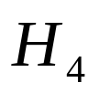
(c)

Slide 14
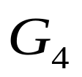
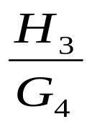
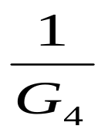
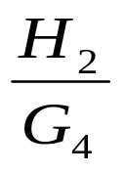
Solution:
1. Moving pickoff point A behind block

Slide 15
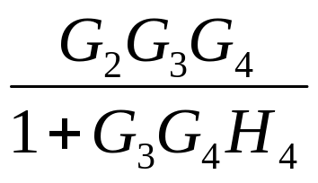



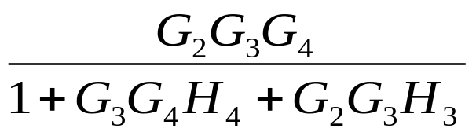
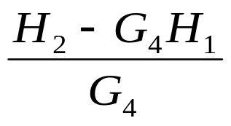
2. Eliminate loop I and Simplify
feedback
Not feedback

Slide 16
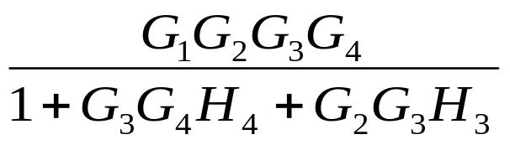
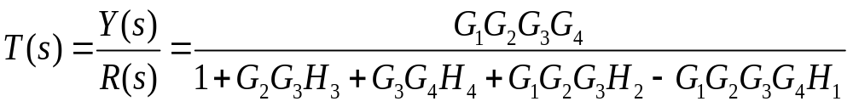
3. Eliminate loop II & IIII
Using rule 6

Slide 17
(d)

Slide 18
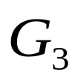


Solution:
1. Moving pickoff point A behind block

Slide 19
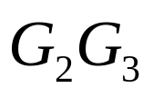
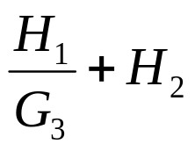
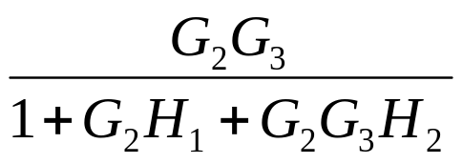

2. Eliminate loop I & Simplify

Slide 20
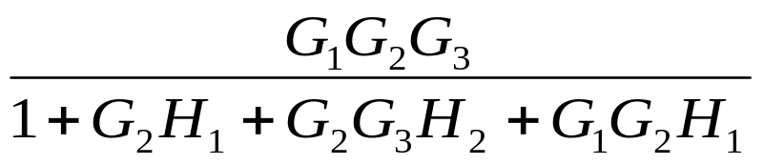
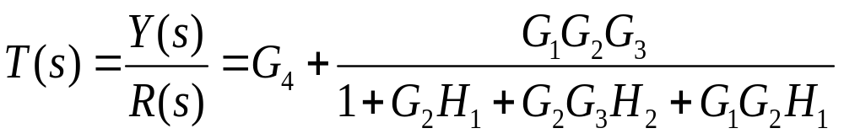
3. Eliminate loop II

Slide 21



Example 2
Determine the effect of R and N on Y in the following diagram

Slide 22
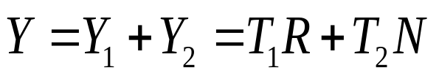
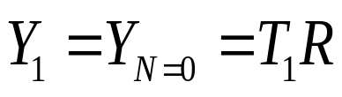
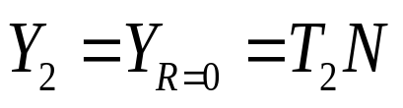
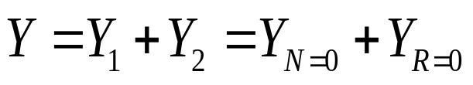
In this linear system, the output Y contains two parts, one part is related to R and the other is caused by N:
If we set N=0, then we can get Y1:
The same, we set R=0 and Y2 is also obtained:
Thus, the output Y is given as follows:

Slide 23

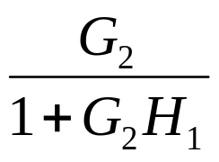
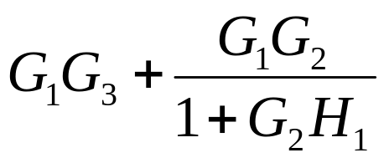
Solution:
1. Swap the summing points A and B
2. Eliminate loop II & simplify

Slide 24


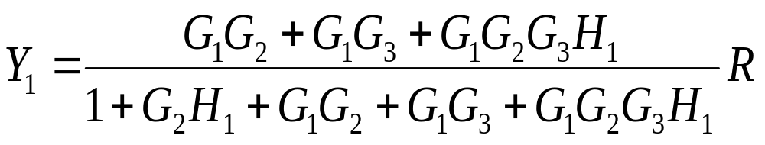
Rewrite the diagram:
3. Let N=0
We can easily get

Slide 25


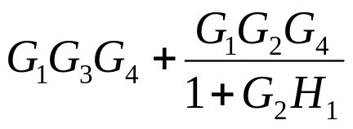

4. Let R=0, we can get:
5. Break down the summing point M:

Slide 26
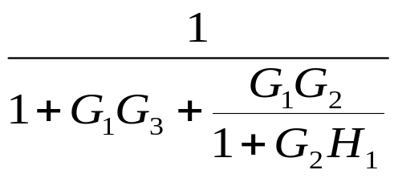
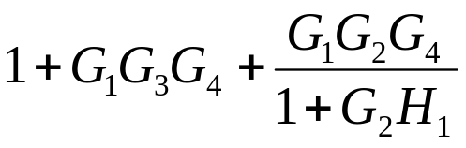
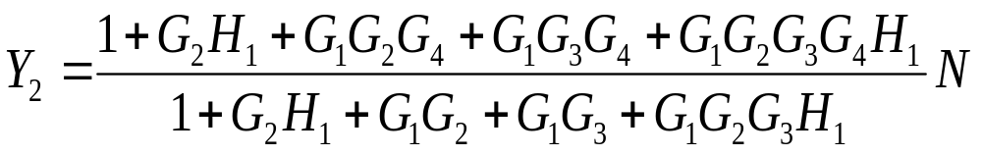

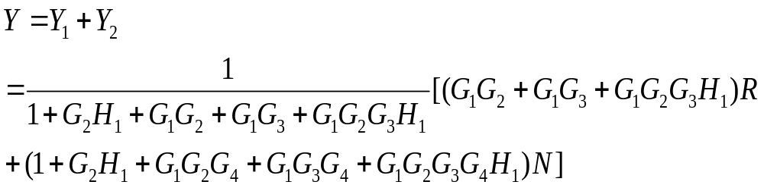
6. Eliminate above loops:
7. According to the principle of superposition, and can be combined together, So:

Slide 27
End

